Slide 1


SESION 2 MODULO 2 BIG DATA ARCHITECTURES
AWS GLUE
Value proposition
2017

Slide 2
Índice
01 Introduction AWS Glue
What is it?
Concepts
Applications
How is AWS Glue different?
02. AWS Glue components
AWS Glue Data catalog
AWS Glue Studio
AWS Glue Databrew
03. AWS Glue use cases
04.Conclusions and Questions

Slide 3
AWS Glue Introducción
01
What is it?
Concepts
Uses

Slide 4



AWS Glue What is?
AWS Glue-¿What is?

Slide 5

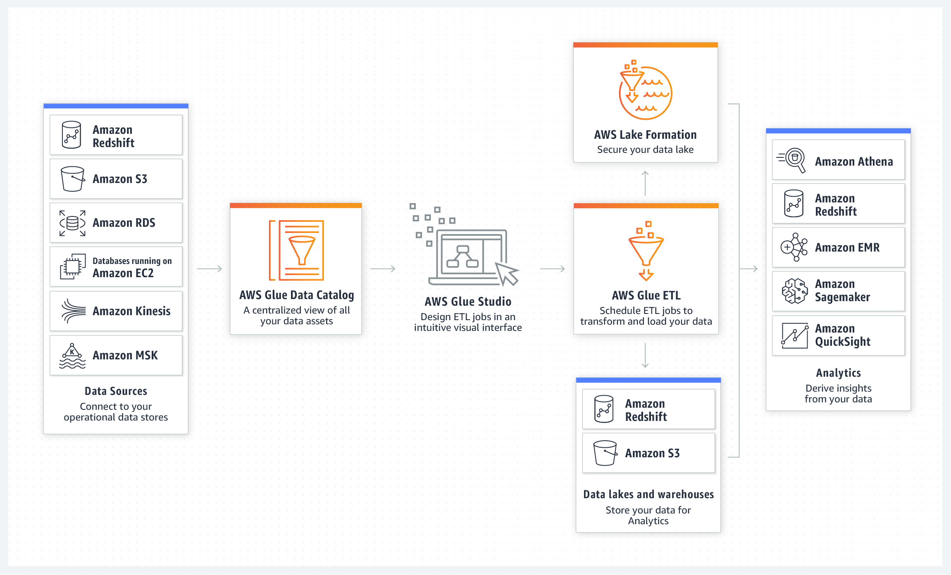
AWS Glue is a fully managed ETL (extract, transform, and load) service that makes it simple and cost-effective to categorize your data, clean it, enrich it, and move it reliably between various data stores and data streams
AWS Glue-¿What is?
Discover: Automatically discover and categorize the data
Designed to work with semi-structured and Structured data
ETL: Clean , enrich and relyable move between different data sources
AWS Glue API operations to interface with AWS Glue services.
Deploy: Run Jobs of ETL in serverless

Slide 6
AWS Features
AWS Glue-¿What is?
Data Discovery The AWS Glue Data Catalog is your persistent metadata store for all your data assets, regardless of where they are located. The Data Catalog contains table definitions, job definitions, schemas, and other control information to help you manage your AWS Glue environment.
Data Transformation AWS Glue Studio allows you to author highly scalable ETL jobs for distributed processing without becoming an Apache Spark expert
Data Replication. AWS Glue Elastic Views enables you to create views over data stored in multiple types of AWS data stores, and materialize the views in a target data store of your choice.
1
Serverless
Data Preparation. AWS Glue helps clean and prepare your data for analysis without becoming a machine learning expert. Its FindMatches feature deduplicates and finds records that are imperfect matches of each other.
2
Schema Inference
3
Autogen ETL Scripts

Slide 7
Components and capabilities of AWS Glue
AWS Glue-Components
Presencia en productos por porcentaje de facturación²
Name
Description
Capabilities
Extract data from different sources: Amazon S3, Amazon Kinesis or JDBC and move to different targets,
Visually configure, execute, and monitor data transformations
Review schemas of a dataset
AWS Glue Studio
Visual interface to visually create, run, and monitor ETL flows with just a few clicks
80%
AWS Glue Data Catalog
Persistence metadata store
It provides a uniform repository where diferents systems can store and find metadata to keep track of data-
In addition provides comprehensive audit and governance capabilities, with schema change tracking
8%
Profile
Clean and Normalize
Map
Automate
AWS Glue Data Brew
AWS Glue DataBrew is a new visual data preparation
34%
AWS Glue Elastic Views
Use familiar SQL to create a materialized view
Automatically copies data from each source data store to a target data store
Automatically keeps the data in the target data store updated
AWS Glue Elastic Views makes it easy to build materialized views that combine and replicate data across multiple data stores without you having to write custom code.
5%

Slide 8
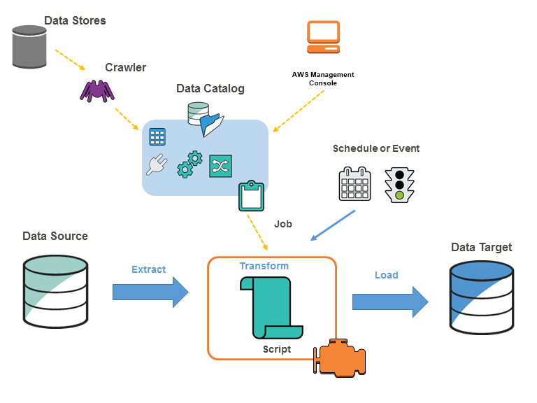
The following diagram shows the architecture of an AWS Glue environment
AWS Glue-Architecture

Slide 9
Some important AWS Glue terms are:
AWS Glue-Terminology
Classifier
Determines the schema of your data. AWS Glue provides classifiers for common file types, such as CSV, JSON, AVRO, XML, and others. It also provides classifiers for common relational database management systems using a JDBC connection. You can write your own classifier by using a grok pattern or by specifying a row tag in an XML document.
Crawler
A program that connects to a data store (source or target), progresses through a prioritized list of classifiers to determine the schema for your data, and then creates metadata tables in the AWS Glue Data Catalog
Job
The business logic that is required to perform ETL work. It is composed of a transformation script, data sources, and data targets. Job runs are initiated by triggers that can be scheduled or triggered by events.
The metadata definition that represents your data. Whether your data is in an Amazon Simple Storage Service (Amazon S3) file, an Amazon Relational Database Service (Amazon RDS) table, or another set of data, a table defines the schema of your data. A table in the AWS Glue Data Catalog consists of the names of columns, data type definitions, partition information, and other metadata about a base dataset
Table
Connection
Properties are needed to connect the Data Catalog to a specific data store. If you are using the S3 data store as your data source and data target, then there is no need to create a connection.
Data Store, Data Source and Data Target
Storing up the data is done in a repository called Data Store. Data Source is the same as Data Store, but it is used as input data for transformations. The transformation of data is written to a Data Target, which is the Data Store..

Slide 10
Use AWS Glue to organize, cleanse, validate, and format data for storage in a large data repository like data warehouse or data lake
AWS Glue-Uses
Discovers and catalogs metadata about differents data stores into a central catalog. Is possible to process semistructured data, such as clickstream or process logs
Populates the AWS Glue Data Catalog with table definitions from scheduled crawler program. The service can automatically find the structured or unstructured data from different repositories.
The service then profiles data in its Glue Data Catalog, which is a metadata repository for all data assets that contain details such as table definition, location and other attributes
Discover and Classify
Generates ETL scripts to transform, aggregate, and enrich your data from source to target.
Detects schema changes and adapts based on the necessities
Schedule ETL jobs with different options : periodically, based in event , with dependencies
Automate ETL Jobs
Gathers runtime metrics to monitor the activities of your data warehouse or data lake.
Handles errors and retries automatically.
Scales resources, as needed, to run your jobs.
Monitoring
Understanding
Makes it easy to maintain a unified view of data using AWS Glue Data Catalog.
Find and discover the data sets you own and keep relevant metadata in a central repository
With AWS Glue streaming, you can create serverless ETL jobs that run continuously, consuming data from streaming services like Kinesis Data Streams and Amazon MSK.
Streams

Slide 11
AWS Glue Components
02
Data Catalog
Glue Studio
Data Brew

Slide 12
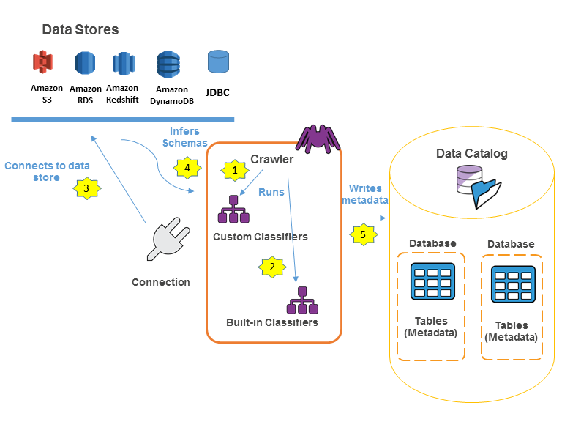
Workstream to catalog the data sources with AWS Glue Data Catalog
AWS Glue Data Catalog
1
A crawler runs any custom classifiers that you choose to infer the format and schema of your data. You provide the code for custom classifiers, and they run in the order that you specify.
The first custom classifier to successfully recognize the structure of your data is used to create a schema. Custom classifiers lower in the list are skipped.
If no custom classifier matches your data's schema, built-in classifiers try to recognize your data's schema. An example of a built-in classifier is one that recognizes JSON.
The crawler connects to the data store. Some data stores require connection properties for crawler access
.
The inferred schema is created for your data.
The crawler writes metadata to the Data Catalog. A table definition contains metadata about the data in your data store. The table is written to a database, which is a container of tables in the Data Catalog. Attributes of a table include classification, which is a label created by the classifier that inferred the table schema.
2
3
4
5
6

Slide 13
AWS Glue Data Catalog Introduction
AWS Glue Data Catalog

Slide 14

The AWS Glue Data Catalog consists of the following components: Databases and tables, Crawlers and classifiers, Connections and AWS Glue Schema Registry
AWS Glue Data Catalog
Databases and Tables
The Data Catalog consists of databases and Tables. A table can be in only one database. Your database can contain tables from many different sources that AWS Glue supports.
Crawlers
Amazon S3
DynamoDB
Crawlers can crawl the following data stores through a JDBC connection:
Amazon Redshift
Amazon Relational Database Service (Amazon RDS)
Amazon Aurora
Microsoft SQL Server
MySQL
Oracle
PostgreSQL
Classifiers
In the AWS Glue crawler, a classifier recognizes the format of the data and generates the schema. AWS Glue comes with set of built-in classifiers, but you can also create custom classifiers.
The built-in classifiers for various formats include JavaScript Object Notation (JSON), comma-separated values (CSV), web logs, and many database systems.
There are many built-int classifiers types : Apche ORC,Apache Parquet, Apache Avro, JSON, XML, CSV, Oracle, Redshift etc…
AWS Glue Schema Registry
Enables disparate systems to share a schema for serialization and deserialization. For example, assume that you have a producer and a consumer of data. The producer knows the schema when it publishes the serialized data. The consumer uses the Schema Registry deserializer library that parses the schema version ID from the record payload.
Data Catalog

Slide 15
AWS Glue ETL overview
AWS Glue Data Catalog

Slide 16
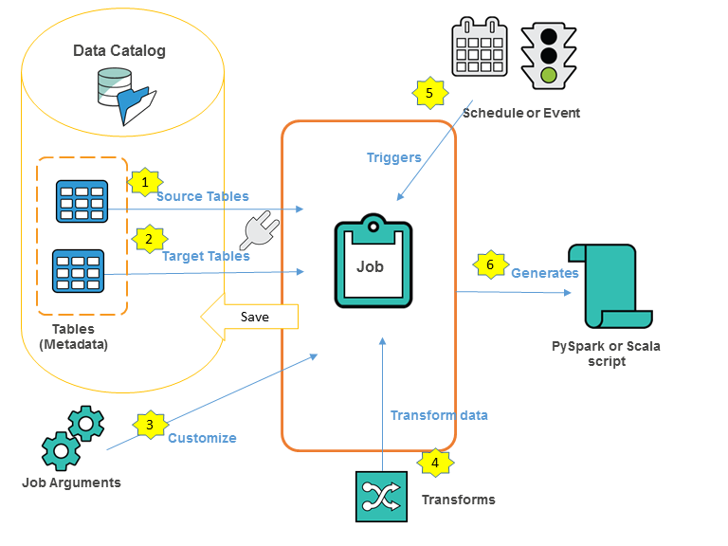
Creation ETL Jobs with AWS Glue
AWS Glue ETL
1
A crawler runs any custom classifiers that you choose to infer the format and schema of your data. You provide the code for custom classifiers, and they run in the order that you specify.
The first custom classifier to successfully recognize the structure of your data is used to create a schema. Custom classifiers lower in the list are skipped.
If no custom classifier matches your data's schema, built-in classifiers try to recognize your data's schema. An example of a built-in classifier is one that recognizes JSON.
The crawler connects to the data store. Some data stores require connection properties for crawler access
.
The inferred schema is created for your data.
The crawler writes metadata to the Data Catalog. A table definition contains metadata about the data in your data store. The table is written to a database, which is a container of tables in the Data Catalog. Attributes of a table include classification, which is a label created by the classifier that inferred the table schema.
2
3
4
5
6

Slide 17
AWS GLUE STUDIO Overview
AWS Glue ETL

Slide 18
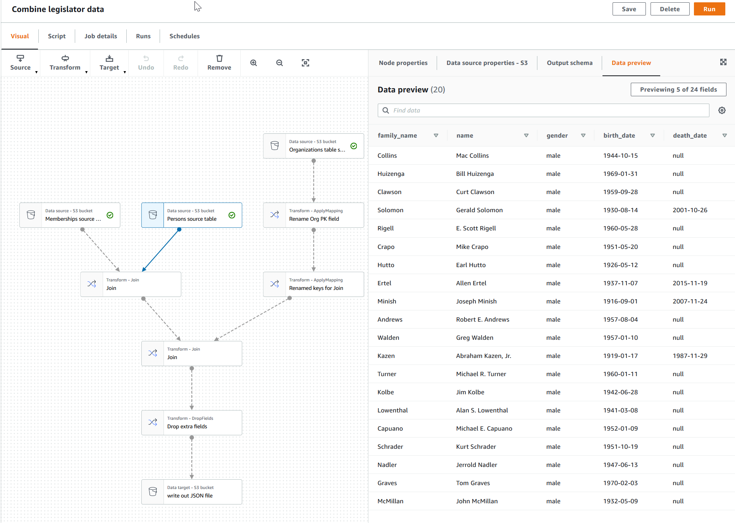
AWS Glue Studio : functionalities
AWS Glue Studio
Visual job editor with the next actions
Add additional nodes to the job to implement:
Multiple data sources.
Multiple data targets.
Transforms:
Join data sources.Select specific fields from the data.
Drop fields.Rename fields. Change the data type of fields.
Split a dataset into two datasets.
Find missing values in a dataset and provide the missing value in a separate column.Use SQL to query and transform the data.Use custom code.
Job script code editor
AWS Glue Studio also has a script editor for writing or customizing the extract-transform-and-load (ETL) code for your jobs. You can use the visual editor in AWS Glue Studio to quickly design your ETL job and then edit the generated script to write code for the unique components of your job. It allows python and Scala Programming Languages
Job performance dashboard
AWS Glue Studio provides a comprehensive run dashboard for your ETL jobs
Support for dataset partitioning
You can use AWS Glue Studio to efficiently process partitioned datasets. You can load, filter, transform, and save your partitioned data by using SQL expressions or user-defined functions–to avoid listing and reading unnecessary data from Amazon S3.

Slide 19
AWS GLUE DataBrew Overview
AWS Glue ETL

Slide 20
AWS GLUE DataBrew Overview
AWS Glue ETL

Slide 21
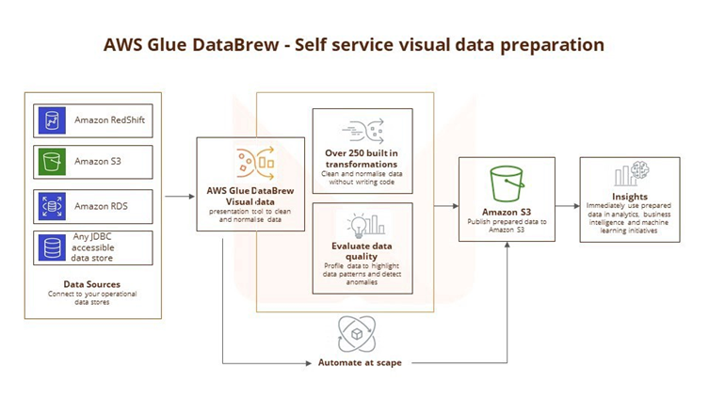
Project with AWS Glue DataBrew
AWS Glue Data Brew
Project:
The interactive data preparation workspace in DataBrew is called a project. Using a data project, you manage a collection of related items: data, transformations, recipies, and scheduled processes..
DataSets: Dataset simply means a set of data—rows or records that are divided into columns or fields.
Recipie:
In DataBrew, a recipe is a set of instructions actions or steps for data that you want DataBrew to act on. Iti is possible to use the transformation tools on the toolbar to set up all the changes that you want to make to your data.
Data Lineage:
This view shows you how the data flows through different entities from where it originally came. You can see its origin, other entities it was influenced by, what happened to it over time, and where it was stored.
DataProfile
When you profile your data, DataBrew creates a report called a data profile. This summary tells you about the existing shape of your data, including the context of the content, the structure of the data, and its relationships.

Slide 22
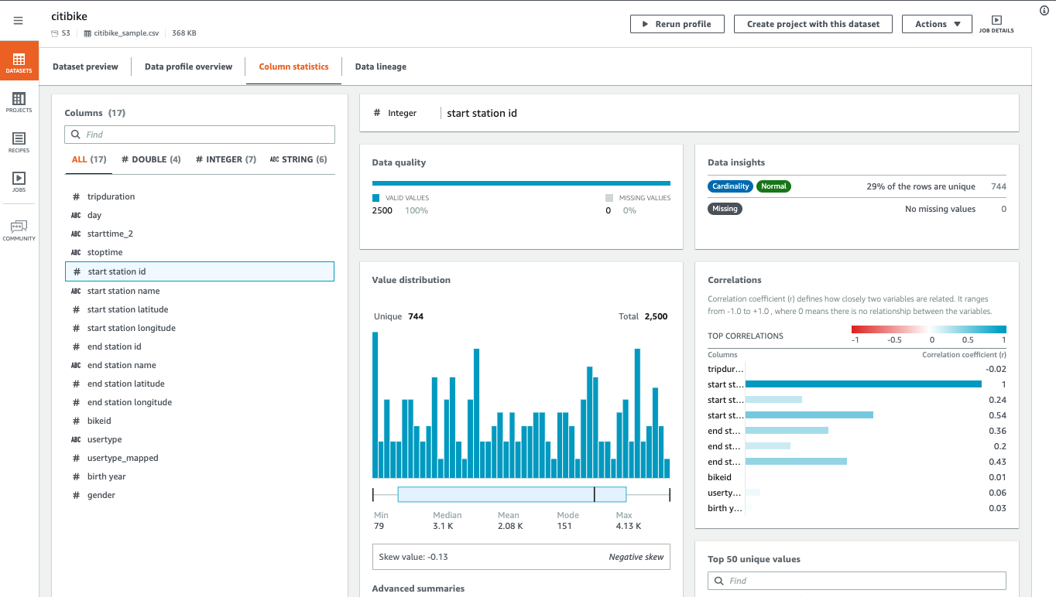
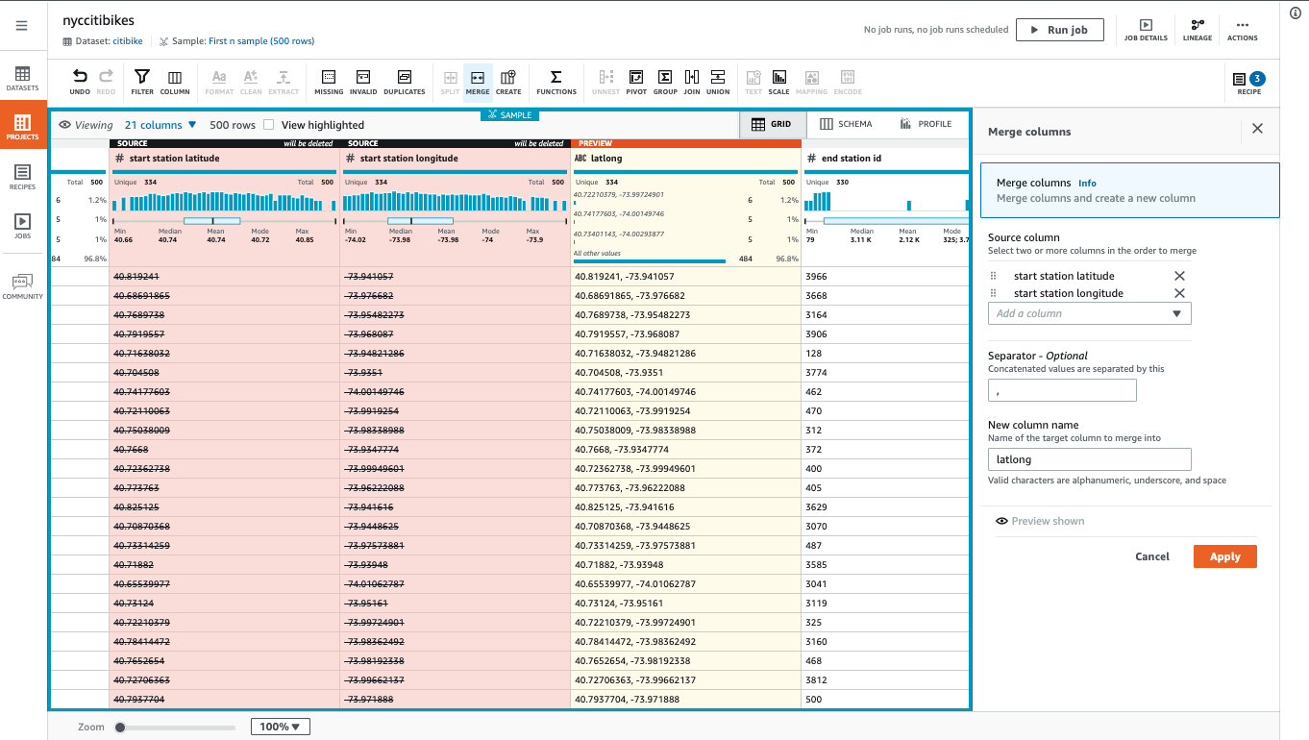
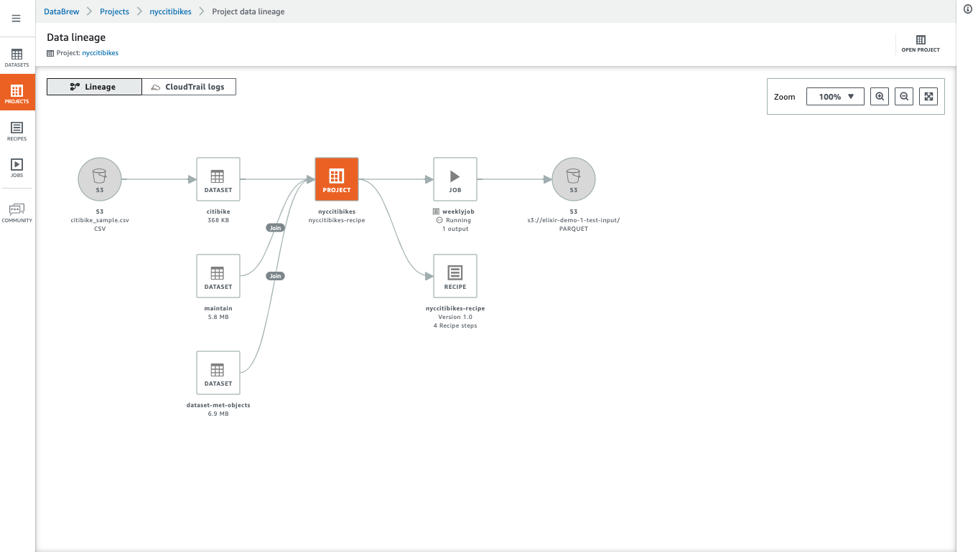
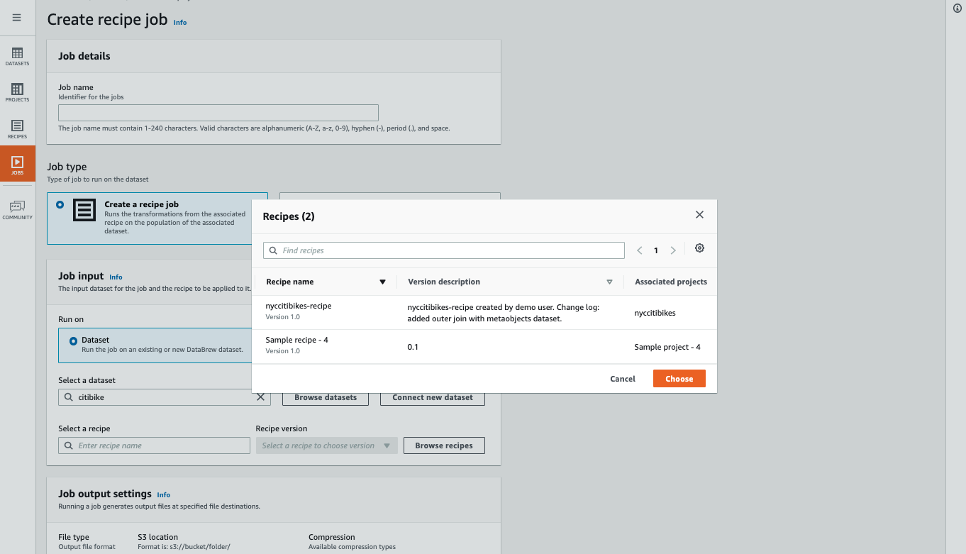
AWS Glue DataBrew Capabilities
AWS Glue Data Brew
Functionalities of data profiling to understand it patterns and detect anomalies; connecting data directly from data lake, data warehouses, and databases.
Provide from over 250 built-in transformations to visualize, clean, and normalize your data with an interactive, point-and-click visual interface.
Visually map the lineage of your data to understand the various data sources and transformation steps that the data has been through.
Automate data cleaning and normalization tasks by applying saved transformations directly to new data as it comes into your source system.

Slide 23
AWS USE CASES
03
Data Catalog
Glue Studio
Data Brew

Slide 24
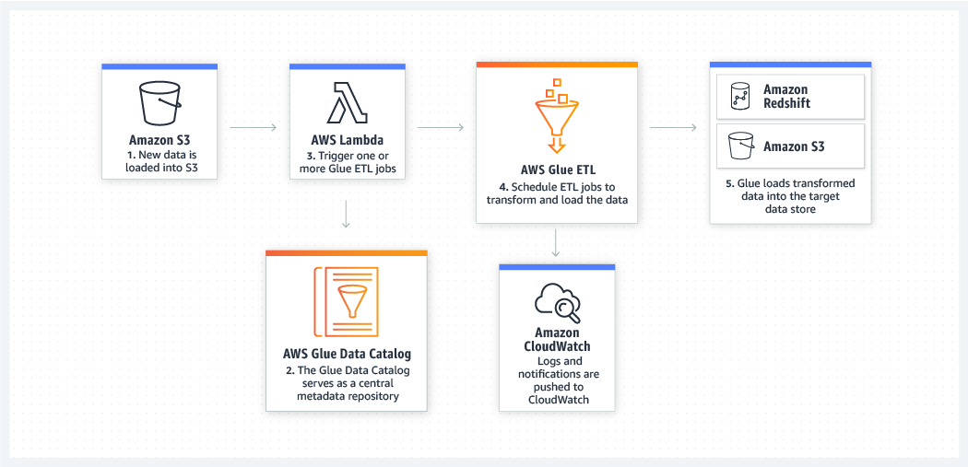
AWS GLUE Use Case
Build event-driven ETL (extract, transform, and load) pipelines
AWS Glue can run your ETL jobs as new data arrives. For example, you can use an AWS Lambda function to trigger your ETL jobs to run as soon as new data becomes available in Amazon S3. You can also register this new dataset in the AWS Glue Data Catalog as part of your ETL jobs.

Slide 25
AWS GLUE Use Case
Create a unified catalog to find data across multiple data stores
You can use the AWS Glue Data Catalog to quickly discover and search across multiple AWS data sets without moving the data. Once the data is cataloged, it is immediately available for search and query using Amazon Athena, Amazon EMR, and Amazon Redshift Spectrum

Slide 26
AWS GLUE Use Case
Explore data with self-service visual data preparation
AWS Glue DataBrew enables you to explore and experiment with data directly from your data lake, data warehouses, and databases, including Amazon S3, Amazon Redshift, AWS Lake Formation, Amazon Aurora, and Amazon RDS. You can choose from over 250 prebuilt transformations in AWS Glue DataBrew to automate data preparation tasks, such as filtering anomalies, standardizing formats, and correcting invalid values. After the data is prepared, you can immediately use it for analytics and machine learning. Learn more about AWS Glue DataBrew

Slide 27
AWS GLUE Use Case
Build materialized views to combine and replicate data (in preview)
AWS Glue Elastic Views enables you to use familiar SQL to create materialized views. Use these views to access and combine data from multiple source data stores, and keep that combined data up-to-date and accessible from a target data store. The AWS Glue Elastic Views preview currently supports Amazon DynamoDB as a source, with support for Amazon Aurora and Amazon RDS to follow. Currently supported targets are Amazon Redshift, Amazon S3, and Amazon OpenSearch Service (successor to Amazon Elasticsearch Service), with support for Amazon Aurora, Amazon RDS, and Amazon DynamoDB to follow.

Slide 28


